Slide 1

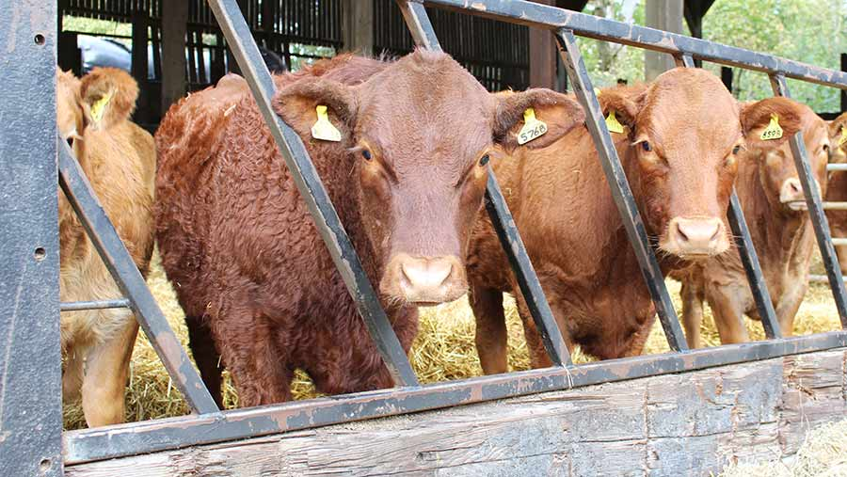
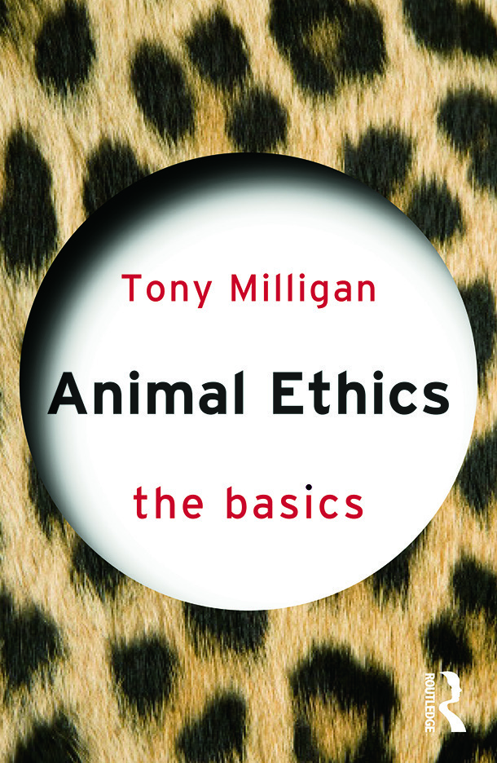
Title: Animal ethics
a ‘Animals should be treated the same as humans’
8
Now compare your snowflake to your partner’s, is it similar or different to your own?
7
6
b ‘Human rights are more important than animal rights’
H: Animal testing is always wrong
5
4
3
2
1
C Animals should be used for food, only if there is no alternative
On your own, complete the snowflake. 1=strongly disagree 8=strongly agree
G ‘All use animals by humans is wrong
D Animals should be used by human beings
F ‘Animals should be used for food’
E ‘Humans are special compared to animals’

Slide 2
Different perspectives on animal rights
Pick on of these sentences
Talk to the person next to you, and finish the sentence in your book.
Animals should be treated ________because
Animals are treated________so
Animals are treated________but

Slide 3
Different philosophical views about animal rights
Each group of 3/4 have a number of cards in which philosophers explain their views about animal rights.
First, rank the cards in order from those you agree with the most to those you agree with the least. In your groups, you must agree on the same order

Slide 4
Different philosophical views about animal rights
Now I have given you a set of quotes from each of these philosophers/thinkers.
Match the quote to the philosopher.
Now consider if any of the quotes could be interpreted in more than one way

Slide 5
Discuss: How might some of the philosophers and thinkers respond to this ethical situation?
Points to consider:
1. Are the wants of humans to eat meat more important than the welfare of animals?
2. Why is intensive farming popular in the UK?
3. If intensive farming is wrong, does that mean that all farming is wrong?
4. Pick two philosophers/thinkers how might they respond to the issue of intensive farming?
Intensive farming
The number of industrial-sized pig and poultry units in the UK has risen by 7% from 1,669 in 2017 to 1,786 this year.
Chicken farms are classed as “intensive” if they have capacity to house at least 40,000 poultry birds, while pig farms must have 2,000 pigs raised for meat or 750 breeding sows. large-scale and intensive methods of farming poultry with high stocking densities and fast-growing breeds have been linked to poor animal welfare.
Driven in part by supermarket pressure to keep prices low and consumer demand for cheap meat, the growth of industrial farming remains divisive.
Intensive pig and poultry farms have been linked to local biodiversity damage from ammonia emissions and to detrimental impacts on local communities including noise pollution, increased traffic, and potentially harmful bacteria, viruses and air pollutants. It is also seen as a driver of deforestation in South America, through its reliance on protein-rich crops such as soya as animal feed.
Notes:
This is part of a larger article about intensive farming in the UK

Slide 6
‘humans should use animals for whatever we please’
What makes the paragraph good?
It is my view that humans should not use animals for whatever they please. An argument against my position comes from the French philosopher Rene Descartes, who argued that humans can use animals for whatever we please because he understood animals to be inferior to humans. Descartes viewed human beings and animals differently; he saw humans as rational (capable of thinking and self-reflection) beings and contrasted this with animals. Descartes viewed animals as irrational and therefore he concluded that animals were unable to experience pain. However, Descartes view has been challenged by modern scientific advancements. As primatologist Jane Goodall’s research has shown Descartes was obviously wrong to claim that animals do not feel pain! Furthermore, Goodall’s research into mourning process of the baby Chimp Flint after the death of his mother Flo shows that some primates can feel complex emotions such as loss and grief. Therefore, animals should not be treated however we please because animals are similar to humans as they can experience pain and loss.
Notes:
Model answer

Slide 7
‘humans should use animals for whatever we please’
It is my view that humans should not use animals for whatever they please.
An argument against my position comes from the French philosopher Rene Descartes.
Descartes argued that humans can use animals for whatever we please because he understood animals to be inferior to humans. Descartes viewed human beings and animals differently; he saw humans as rational (capable of thinking and self-reflection) beings and contrasted this with animals. Descartes viewed animals as irrational and therefore he concluded that animals were unable to experience pain.
However, Descartes view has been challenged by modern scientific advancements. As primatologist Jane Goodall’s research has shown Descartes was obviously wrong to claim that animals do not feel pain!
Furthermore, Goodall’s research into mourning process of the baby Chimp Flint after the death of his mother Flo shows that some primates can feel complex emotions such as loss and grief.
Therefore, animals should not be treated however we please because animals are similar to humans as they can experience pain and loss.
1. A topic sentence that states your view and links to the question/statement
3. Explaining the opposing view fairly + evidence to support your view
2. Introducing a philosopher/thinker that is against your view
4. Now show how the view you oppose is weak by explaining the views of a philosopher that supports your view including evidence to support their view
5. A final sentence showing how the scholar you have used as evidence to support your view links to the statement
Notes:
Model answer

Slide 8
Now it is your turn
‘humans should use animals for whatever we please’
Write one extended paragraph either for or against this view using the same structure that we have discussed on the previous slide.
Use the thinkers we have discussed in this lesson.
Notes:
HW

Slide 9
1. Rene Descartes. Descartes was a French philosopher. He argued that humans are unique because we have a soul. Animals, by contrast, do not have souls and are incapable, according to Descartes, of feeling pain or of reasoning. Therefore, they do not deserve moral consideration. | 2. Aristotle was a Greek philosopher and was taught by Plato. His most famous work is the Nicomachean Ethics. Aristote rarely mentions animals and claims that only humans are capable of achieving eudaimonia (human flourishing). Aristotle suggests that animals should be treated how we wish, but treating animals cruelly could result in people cultivating vices (bad habits) | 3. Stewardship is the Christian view that humans were made by God for the purpose of looking after all of God’s creation including animals
4. Jeremy Bentham was a philosopher and writer. He argued that animals should be treated well because, like humans, they are capable of feeling pain. However, his ethical system - Utilitarianism states that an action is good if it is the ‘greatest happiness for the greatest number of people’ | 5. Dominion is the Christian view that humans are made in the ‘image of God’ and therefore can treat animals and the environment any way they wish. | 6. Ahimsa is a concept that is prevalent across Hinduism, Jainism and Buddhism. It means ‘no harming’
7. Peter Singer is an ethicist. He argues that most ethical ethical systems are ‘speciesist’ because they privilege human lives over animal or other lives. Singer takes Bentham’s idea of the ‘greatest good for the greatest number of people’ and says that it should apply to animals because animals have a preference for not feeling pain. Therefore, animal testing (for ecample) should only be used if the happiness produced outweighs the pain of animal suffering. | 8. Jane Goodall is a primatologist shows that some animals are able to experience grief and a sense of loss when a child dies.

Slide 10
a) “It is also a very remarkable fact that although many animals show more skill than we do in some of their actions, yet the same animals show none at all in many others” Therefore, animals are different to humans | e)“The question is not, Can they reason?, nor Can they talk? but, Can they suffer?) | f) Then God said, “I give you... the beasts of the earth and all the birds in the sky and all the creatures that move along the ground—everything that has the breath of life in it—I give every green plant for food.” And it was so. (Genesis 1.29-30)
c) ‘”We are what we repeatedly do. Excellence is not an act, but a habit.” | g) Each of you should use whatever gift you have received to serve others, as faithful stewards of God’s grace in its various forms. 1 Peter 4.10 | b) Ahimsa is the highest duty. Even if we cannot practice it in full, we must try to understand its spirit and refrain as far as is humanly possible from violence. - Mahatma Gandhi
d) “All the arguments to prove man's superiority cannot shatter this hard fact: in suffering the animals are our equals.” | h) Not just humans experience feelings of grief and loss. This was shown through the mourning and grieving process shown by 8 year old chimpanzee Flint following the death of his mother Flo.

Slide 11
a ‘Animals should be treated the same as humans’
8
a ‘Animals should be treated the same as humans’
8
7
7
6
b ‘Human rights are more important than animal rights’
6
b ‘Human rights are more important than animal rights’
H: Animal testing is always wrong
5
5
H: Animal testing is always wrong
4
4
3
3
2
2
1
1
C Animals should be used for food, only if there is no alternative
C Animals should be used for food, only if there is no alternative
G ‘All use animals by humans is wrong
G ‘All use animals by humans is wrong
D Animals should be used by human beings
D Animals should be used by human beings
F ‘Animals should be used for food’
F ‘Animals should be used for food’
E ‘Humans are special compared to animals’
E ‘Humans are special compared to animals’

